Slide 1
$∑oφoς$- Forward Secure Searchable Encryption
Raphael Bost
CCS 2016
汇报人：魏佩

Slide 2




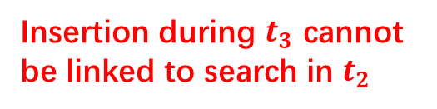





西安邮电大学
Xi'an University of Posts and Telecommunications
Forward Privacy
$$({id}_{1},w_{1})$$
$$t_{1}$$
insert
$$w_{1}$$
用户
$$t_{2}$$
Cloud Server
search
$$({id}_{2},w_{1})$$
$$t_{3}$$
insert
Insertion during $t_{3}$ cannot
be linked to search in $t_{2}$

Slide 3



西安邮电大学
Xi'an University of Posts and Telecommunications
文件注入攻击
攻击思想：敌手注入$d=[logK]个$文档，其中K是总关键词的数量，每个文档中包含K/2个关键词，从而使攻击者高效精确的判断用户查询的关键词内容。
检索结果
$$F_{1}$$
$$w_{0}$$ | $$w_{1}$$ | $$w_{2}$$ | $$w_{3}$$ | $$w_{4}$$ | $$w_{5}$$ | $$w_{6}$$ | $$w_{7}$$
0
$$F_{2}$$
$$w_{0}$$ | $$w_{1}$$ | $$w_{2}$$ | $$w_{3}$$ | $$w_{4}$$ | $$w_{5}$$ | $$w_{6}$$ | $$w_{7}$$
1
$$F_{3}$$
$$w_{0}$$ | $$w_{1}$$ | $$w_{2}$$ | $$w_{3}$$ | $$w_{4}$$ | $$w_{5}$$ | $$w_{6}$$ | $$w_{7}$$
0

Slide 4
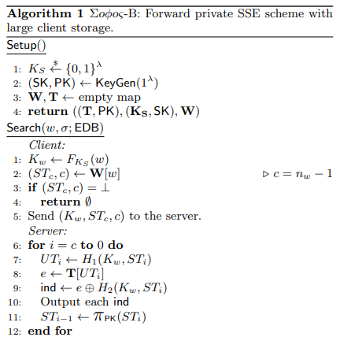
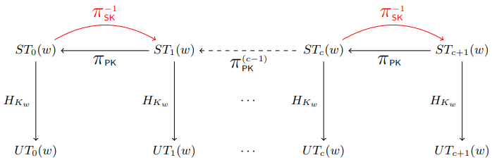
西安邮电大学
Xi'an University of Posts and Telecommunications

Slide 5
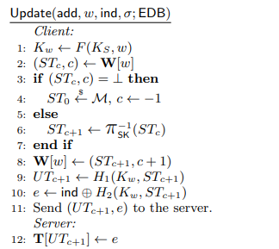
西安邮电大学
Xi'an University of Posts and Telecommunications

Slide 6
THANKS!

